Slide 1
Design Patterns
Guan Wang

Slide 2
What is Design Pattern?
Design Patterns are models of code that solve classic problems. They are solutions to software design problems that you can find in a real-world application.
A Design Pattern is not a code that is ready to be used in your application, but it is a model that you can use to solve a problem.
Sometimes you do not need a design pattern, we should just use it when it is necessary.
Notes:
Rules to follow

Slide 3
Elements of a Design Pattern
A name — that is used to describe a design problem, the solution and the consequences.
The problem — that describes when we need to apply the pattern, explaining the problem and its context.
The solution — that describes the elements that make up the design, the relationships, the responsibilities and collaborations. The solutions do not describe a concrete implementation, because a pattern is like a template which can be applied in many different situations, but provides an abstract description of a design to solve a problem and how a general arrangement of elements (classes and objects) solves it.
The consequences — that are the results of applying the pattern.

Slide 4
Design Patterns (23)
Creation Pattern
Factory — Provide an interface for creating families of related or dependent objects without specifying their concrete classes.
Singleton — Ensure a class only has one instance, and provide a global point of access to it.
Builder — Separate the construction of a complex object from its representation so that the same construction process can create different representations.
Structural Pattern
Decorator — Attach additional responsibilities to an object dynamically. Decorators provide a flexible alternative to subclassing for extending functionality.
Adapter — Convert the interface of a class into another interface clients expect. Adapter lets classes work together that couldn’t otherwise because of incompatible interfaces.
Behavioral Pattern
Observer — Define a one-to-many dependency between objects so that when one object changes state, all its dependents are notified and updated automatically.
Chain of Responsibility — Avoid coupling the sender of a request to its receiver by giving more than one object a chance to handle the request. Chain the receiving objects and pass the request along the chain until an object handles it.

Slide 5
Factory Pattern
Provide an interface for creating independent objects without specifying their concrete classes.
Roles:
Factory (Creator)
Abstract Product
Concrete Product
Pros and cons:
Pros: Details used to initiate products are hidden from the client. Client does not need to modify the code.
Cons: It puts all creation logics in one factory. When a new product is needed, the factory should be modified.

Slide 6
Factory Method Pattern
Define an interface for creating an factory, but let subclasses decide which class to instantiate. Factory Method lets a class defer instantiation to subclasses.
Roles:
Abstractive Factory (Creator)
Concrete Factory (Concrete Creator)
Abstractive Product (Product)
Concrete Product
Pros and Cons:
Pros: Every concrete product has a corresponding concrete factory, no need to modify the factory class. Details used to initiate products are hidden from the client.
Cons: A new concrete factory class is needed when a new concrete product is needed.

Slide 7
Abstract Factory Pattern
Provide an interface for creating families of related or dependent objects without specifying their concrete classes.
Notes:
创建一套产品的模式

Slide 8
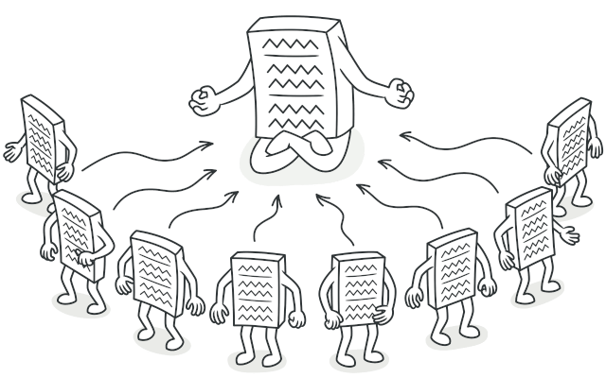
Singleton Pattern
Ensure a class only has one instance, and provide a global point of access to it.
Roles:
Singleton
Pros and no Cons:
Easy to control the access
Equivalent to global variable
prevents the naming space pollution
https://refactoring.guru/
Notes:
Use id() to check two instances to see if they are the same one.
数据库的连接器
操作系统里的文件系统

Slide 9
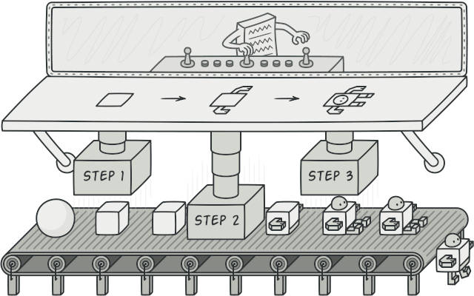
Builder Pattern
Separate the construction of a complex object from its representation so that the same construction process can create different representations.
Roles:
Director
Builder
Concrete Builder
Product
https://refactoring.guru/
Notes:
Director 控制顺序

Slide 10
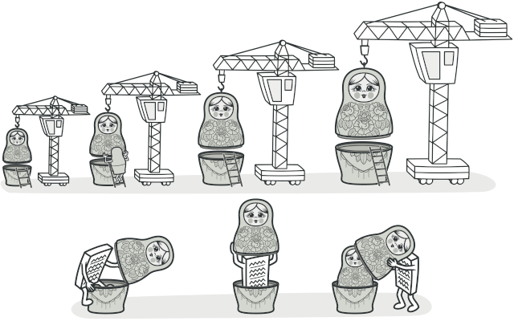
Decorator Pattern
Attach additional responsibilities to an object dynamically. Decorators provide a flexible alternative to subclassing for extending functionality.
Roles:
Decorator
https://refactoring.guru/
Notes:
Director 控制顺序

Slide 11
Adapter Pattern
Convert the interface of a class into another interface clients expect. Adapter lets classes work together that couldn’t otherwise because of incompatible interfaces.
Roles:
Adapter
Target
Adaptee
Two ways:
Multiple Inheritance
Combination
https://refactoring.guru/
Notes:
两个支付系统合并，一个用pay方法，一共cost方法

Slide 12
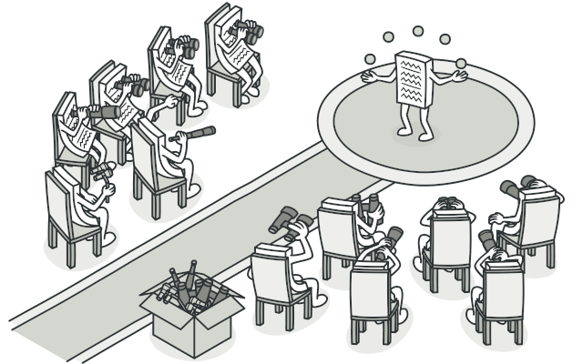
Observer Pattern
Define a one-to-many dependency between objects so that when one object changes state, all its dependents are notified and updated automatically.
Roles:
Observer
Concrete Observer
Subject
Concrete Subject
https://refactoring.guru/
Notes:
两个支付系统合并，一个用pay方法，一共cost方法

